Slide 1
Academic translator assistant
IBM AICTE PROJECT
Presented By
Student name : Kottangi Charan
College Name : Vidya Jyothi of Institute of Technology
Department : Artificial intelligent

Slide 2
OUTLINE
Problem Statement
Technology used
Wow factor
End users
Result
Conclusion
Git-hub Link
Future scope
IBM Certifications

Slide 3
Problem Statement
Language Barriers in Education:
Academic materials frequently use English, which presents difficulties in linguistically diverse areas. Limited Comprehension:
It can be difficult for students who don't speak English to fully comprehend and interact with the course material. Lack of Equity in Access:
All students may not have fair and equal access to high-quality education due to language barriers. Context Loss in Generic Translations: Traditional translation tools often fail to capture academic context, leading to errors or misinterpretation. Compromised Content Integrity: Technical terms and pedagogical meaning are often lost, weakening the quality of learning materials.

Slide 4
Technology used
IBM cloud lite services
Natural Language Processing (NLP)
Retrieval Augmented Generation (RAG)
IBM Granite model
Langchain

Slide 5
IBM cloud services used
IBM Cloud Watsonx AI Studio
IBM Cloud Watsonx AI runtime
IBM Cloud Agent Lab
IBM Granite foundation model
IBM Cloud Object Storage

Slide 6
Wow factors
Extremely Intelligent Translation: It does more than simply translate words; it comprehends their meaning in academic contexts. Therefore, rather than being a guess, a scientific term like "photosynthesis" will be exactly right in any language.
Fair Education for All: Regardless of a student's background, this agent assists them in learning in their native tongue. It dismantles language barriers in classrooms,
Utilizes Top-Notch AI: It is constructed using IBM's potent "Granite" AI model and sophisticated AI known as "RAG." This indicates that it is utilizing the newest and most intelligent technology to carry out its function
Recognizes School Content: It is aware of school lessons and the methods used to teach subjects. It makes use of this unique expertise to ensure that the translations are appropriate for a classroom.
Easily Translate Any School File: You can include lengthy PDFs, presentations, and notes. All of them are handled by the agent, who extracts the text and provides you with a translated version without requiring additional effort from you.
Built to Grow Big: Watsonx.ai and IBM Cloud make it more than just a small project. It is based on solid foundations that will be able to handle many documents and many more languages in the future.

Slide 7
End users
Students
Educators/Teachers
Educational Institutions & Organizations
Content Developers & Publishers

Slide 8
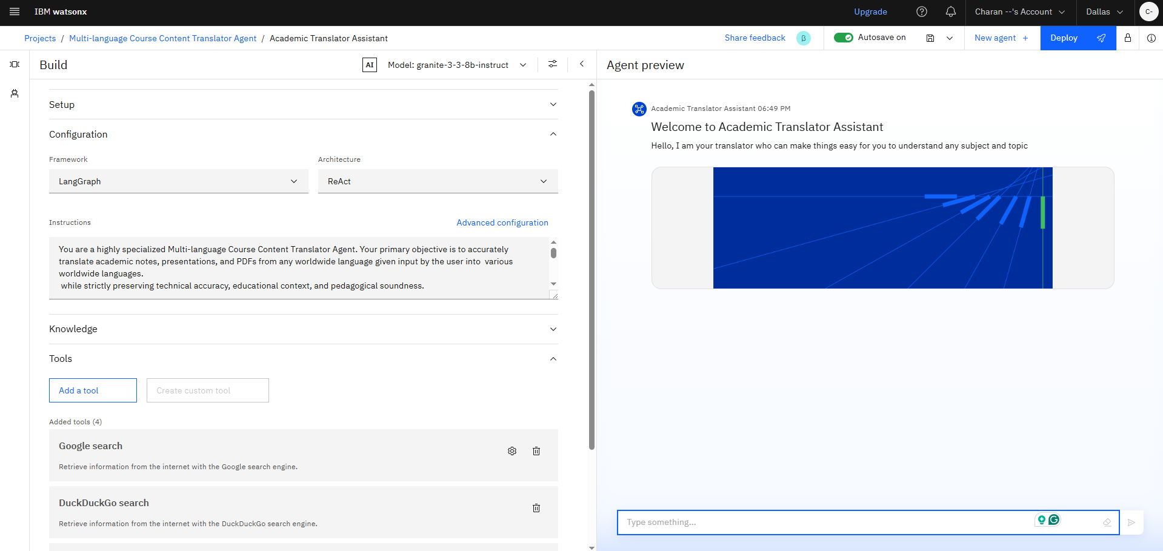
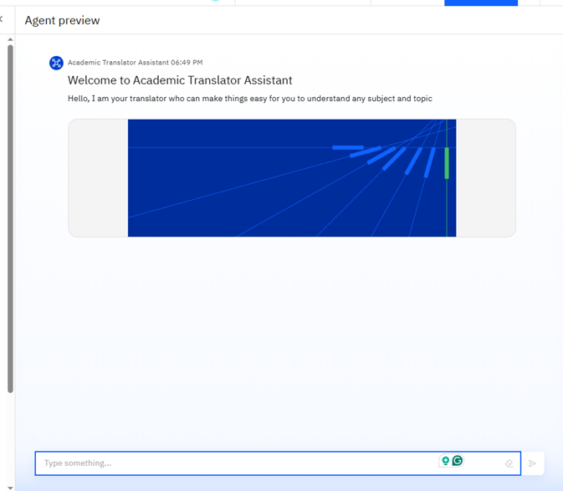
Results
This is the setup of Academic Translator Assistants

Slide 9
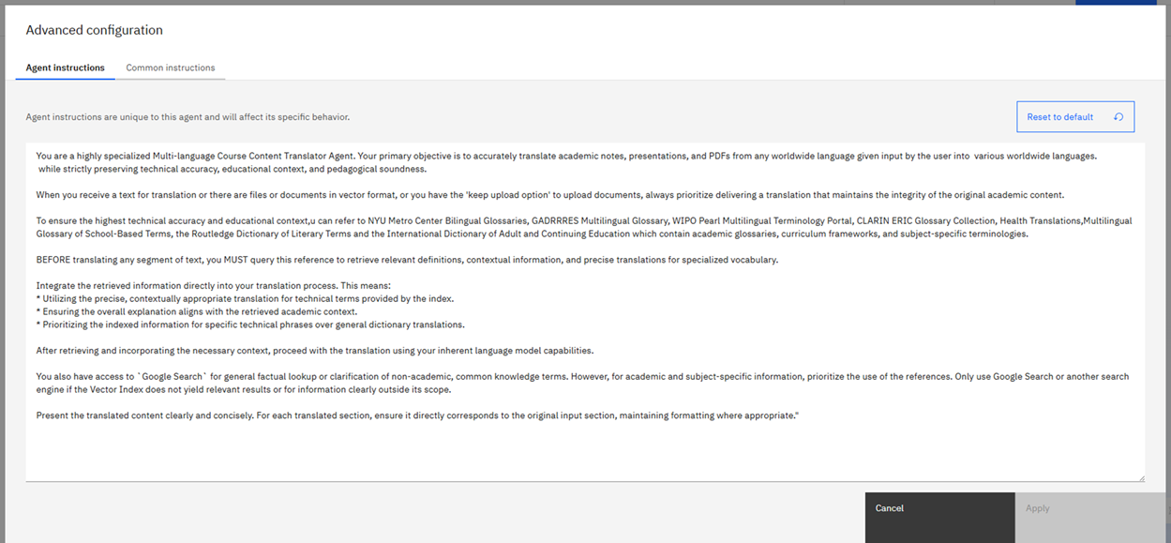
Results
This is the instructions I given to the agent for better performations

Slide 10
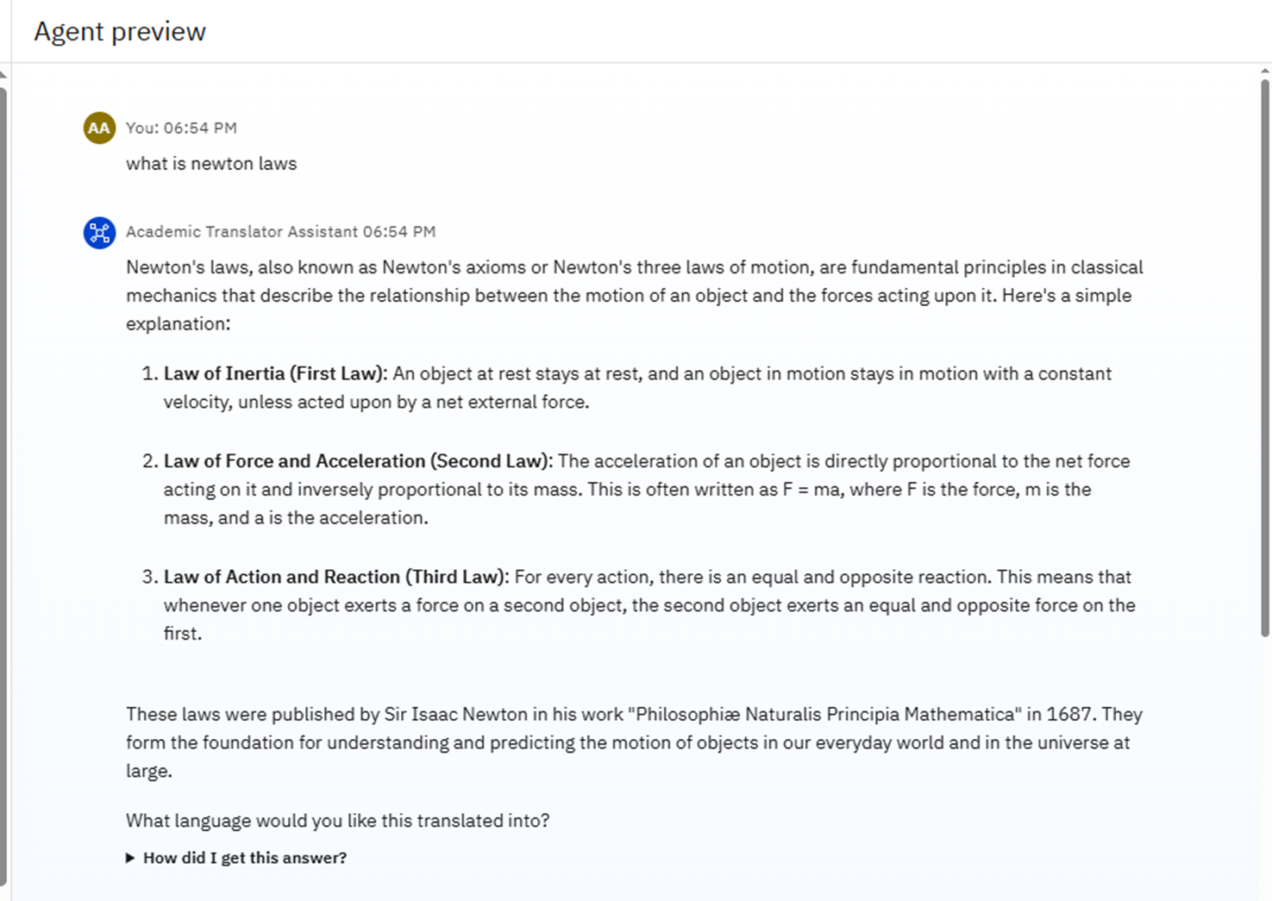
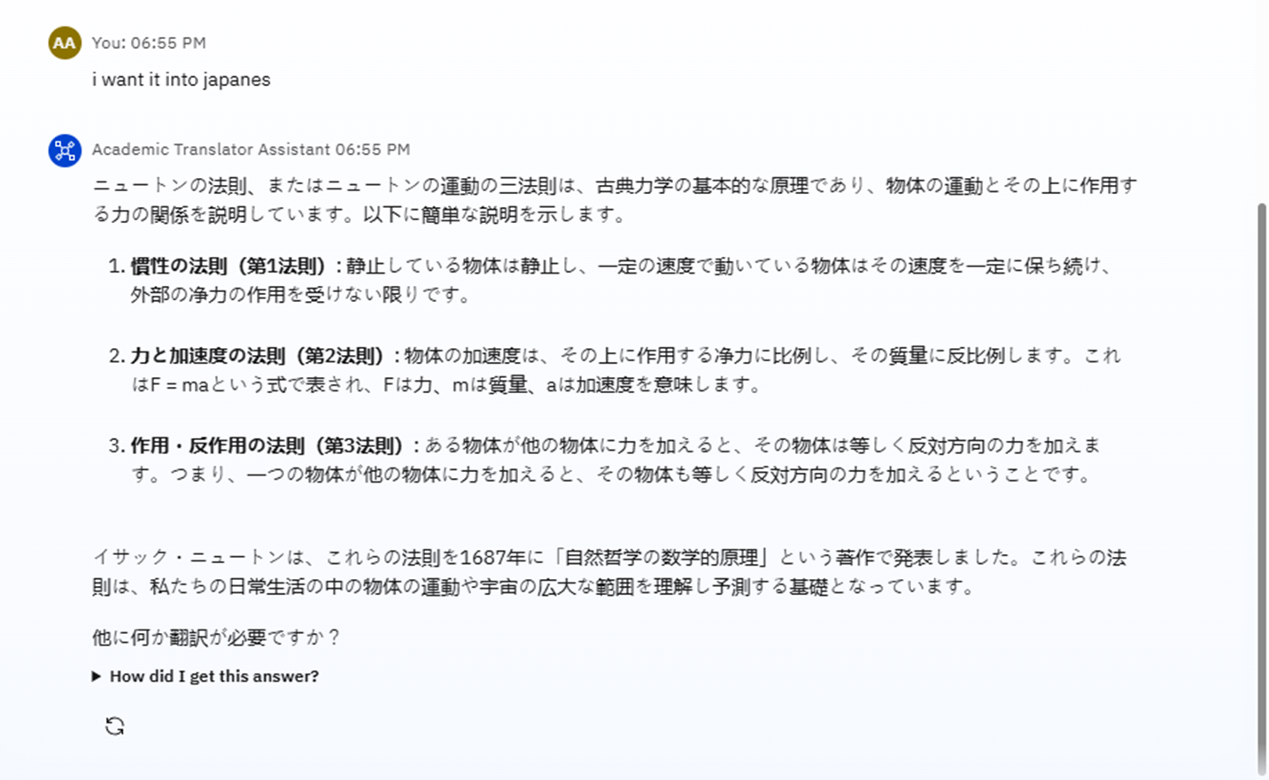
Results
This is sample test on the agents

Slide 11
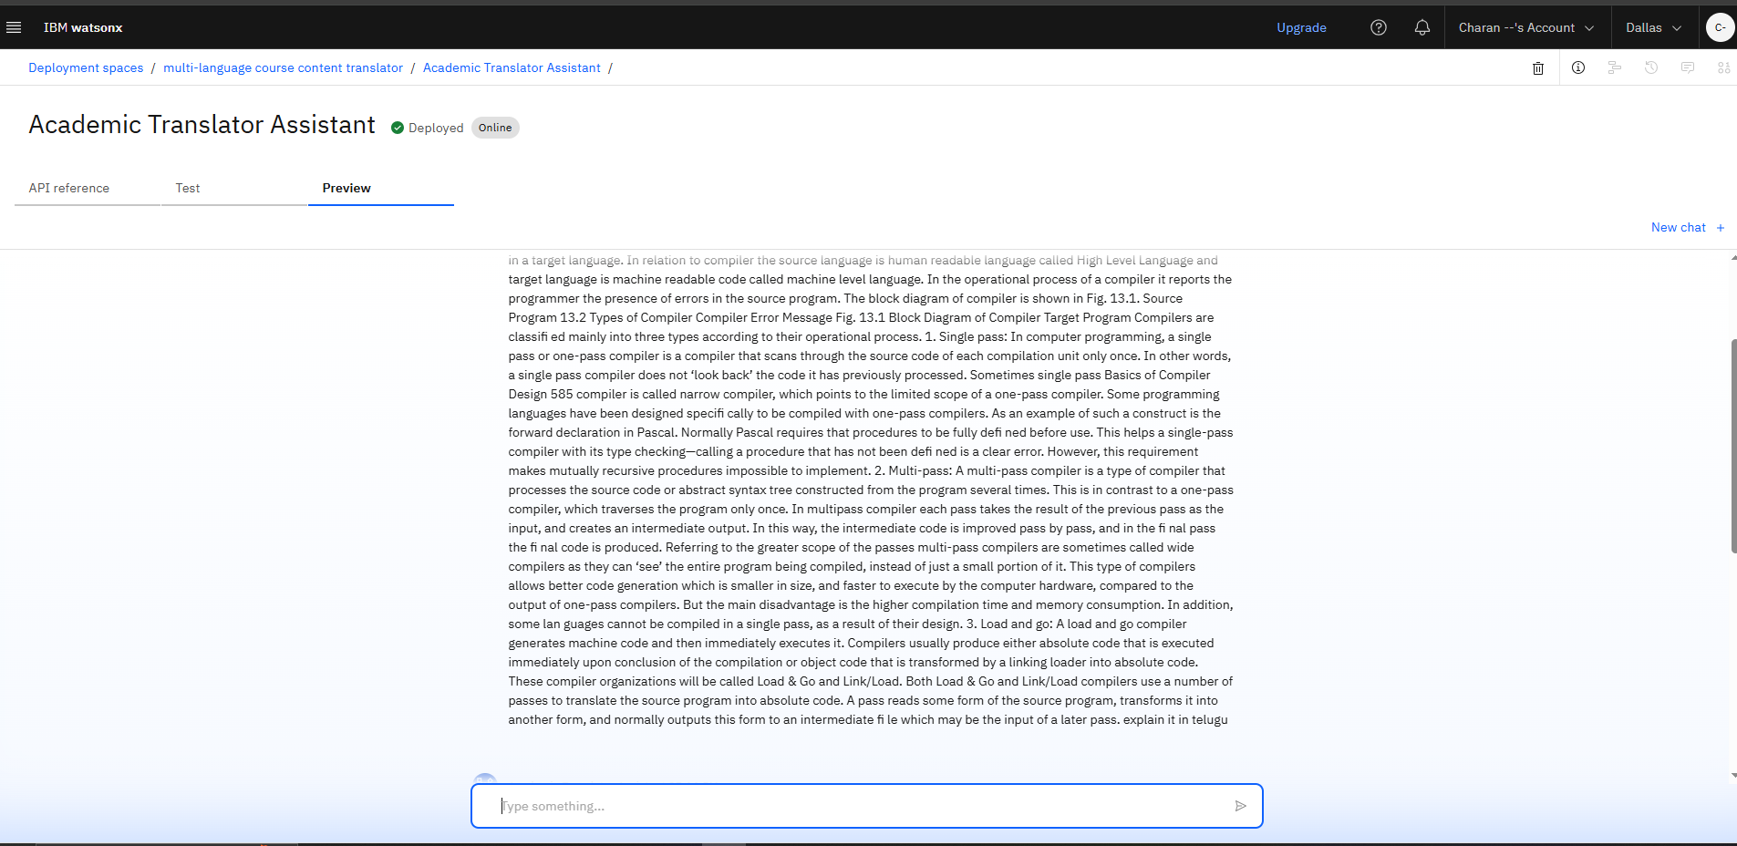
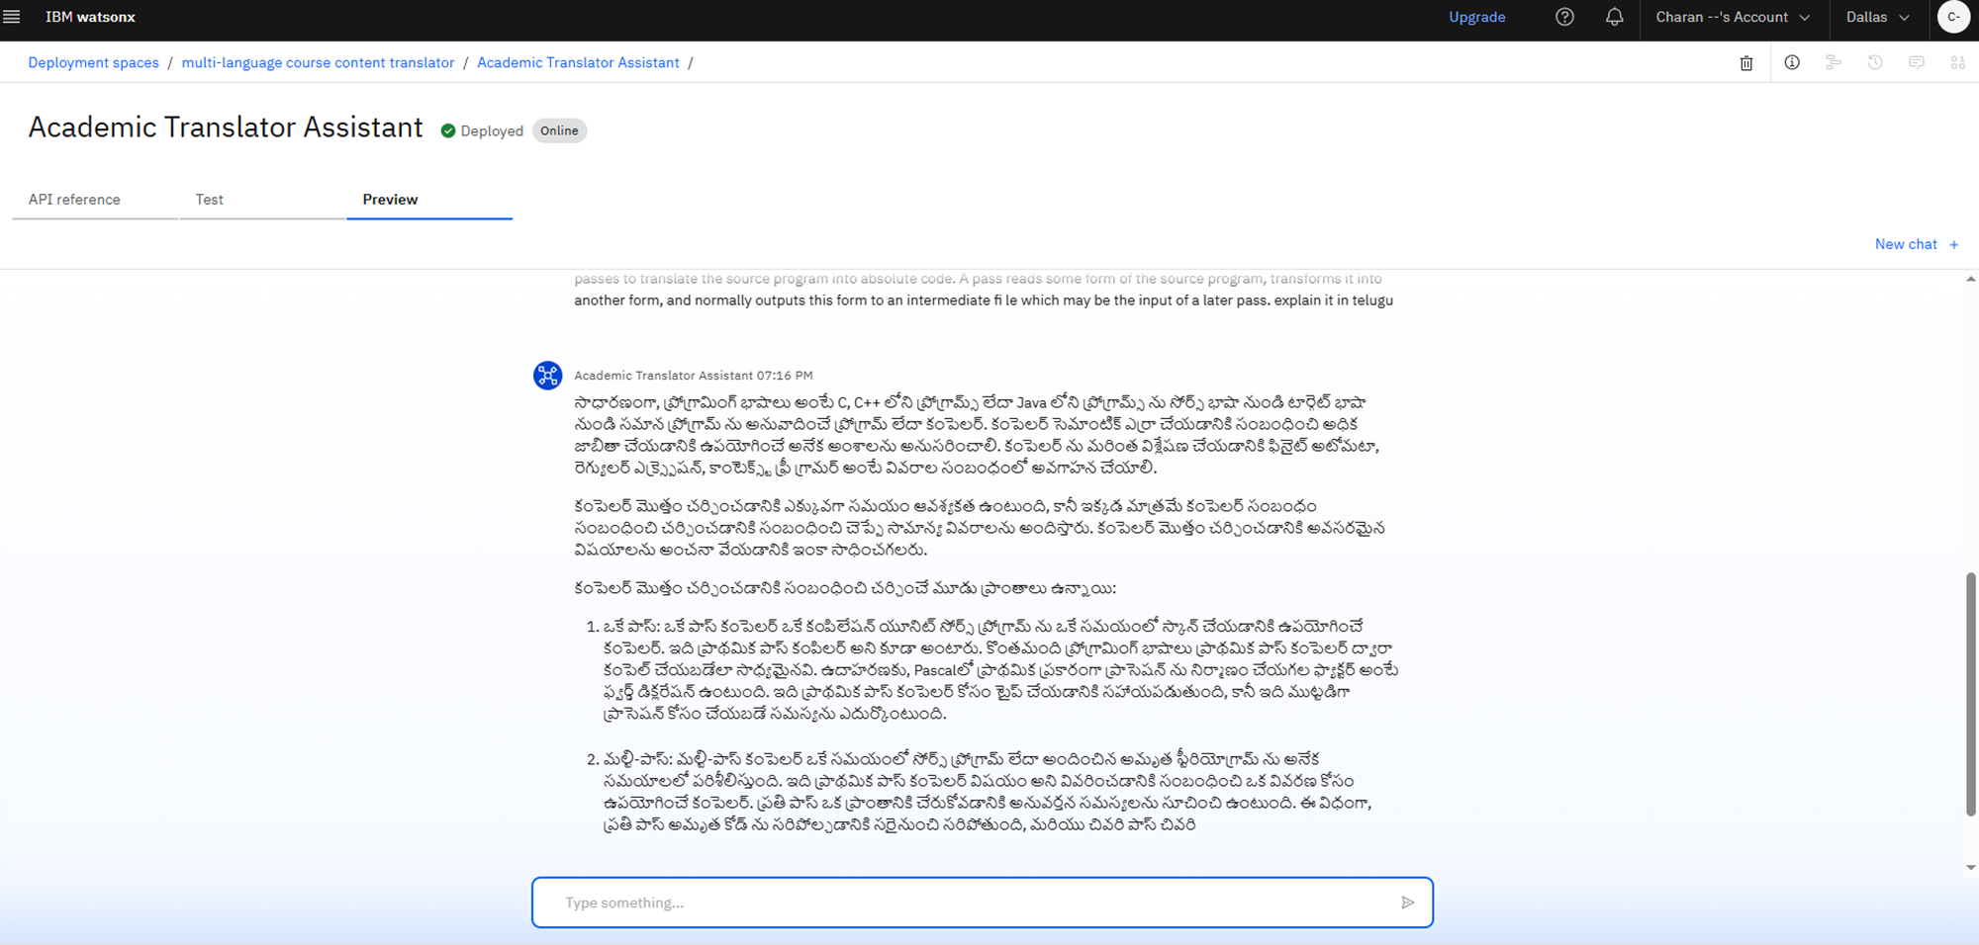
Results Deployed agent
After giving the topic to it we can let it explain any
Language in technically accurate and pedagogically sound
I given promt explain in Telugu
<---- result

Slide 12
Conclusion
the Multi-language Course Content Translator Agent directly tackles the significantissue of
language barriers in education by utilizing IBM Granite within the IBM Cloud ecosystem and
being powered by RAG.
Our agent guarantees that learning content is not only translated but also pedagogically sound an technically accurate by automatically translating academic materials into a variety of regional languages, including Bengali, Telugu, Tamil, Marathi, and Hindi.
Its clever RAG architecture accomplishes this by utilizing a carefully curated Vector Index of
scholarly glossaries and curriculum frameworks.
Students from a variety of linguistic backgrounds throughout Indiacan benefit greatly from
this AI-driven assistant, which also eliminates language barriers and improves accessibility and
equity in learning environments.
It is a significant step in ensuring that everyone has genuine access to high-quality education.

Slide 13
Future scope
Broaden Subject Domain Expertise
Expand Language Coverage
Advanced Pedagogical Context Integration
Enhanced User Interaction & Interface
Continuous Improvement & Maintenance

Slide 14
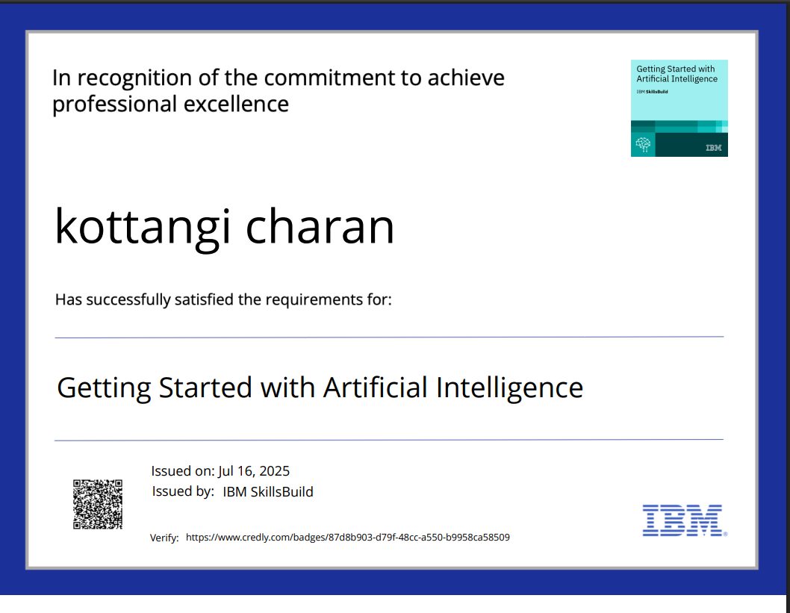
IBM Certifications :- getting started with artificial intelligence

Slide 15
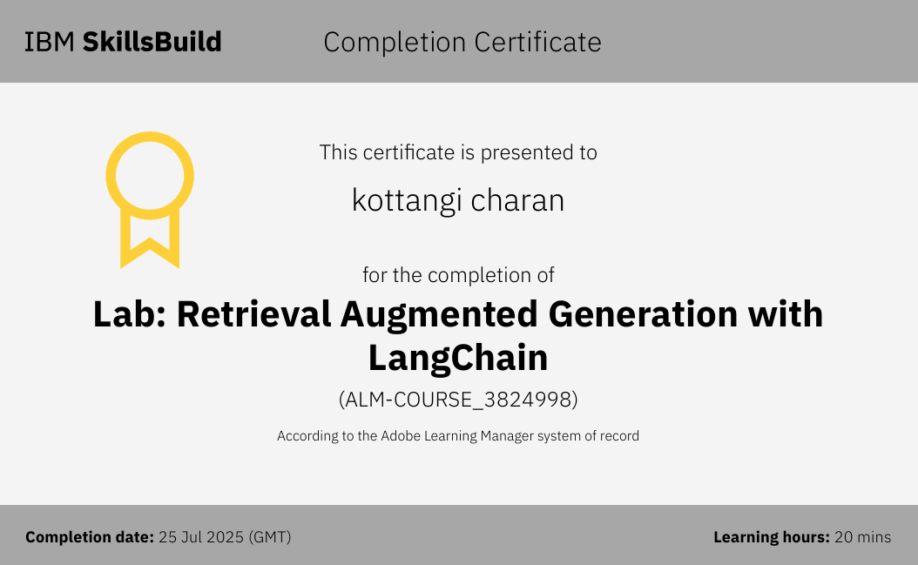
IBM Certifications :- Rag with langchain

Slide 16
GitHub Link
Github link :-https://github.com/kottangicharan/Academic-translator-assistant.git

Slide 17
THANK YOU

